Slide 1
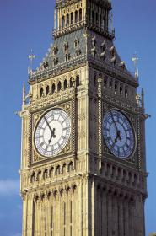
Welcome to the сompetition
“Are you good at English?”

Slide 2
Lexical station

Slide 3
Enjoying your home
10
30
40
20
Shopping for everything
10
20
30
40
School is fun
10
20
30
40
Speaking about seasons and the weather
10
20
30
40

Slide 4
What is it?
a kitchen

Slide 5
What is it?
trainers

Slide 6
What is it?
a blackboard

Slide 7
What is it?
winter

Slide 8
What is it?
The warmest season of the year that is after spring and before autumn

Slide 9
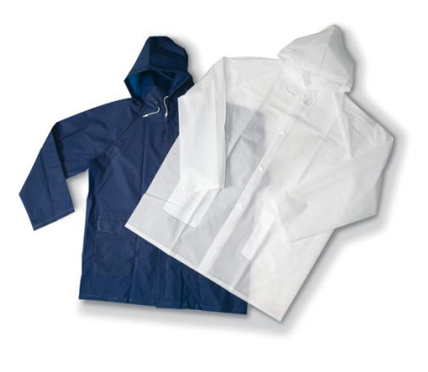
What is it?
A coat that you wear when it rains in order to stay dry

Slide 10
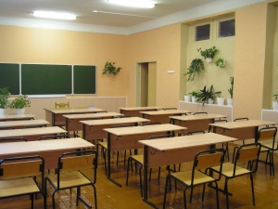
What is it?
A place where classes meet.

Slide 11
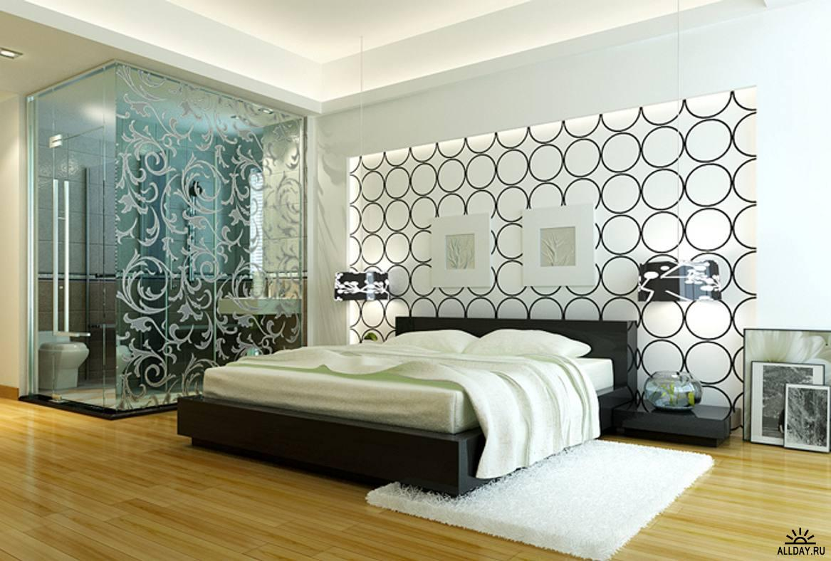
What is it?
A room used for sleeping

Slide 12
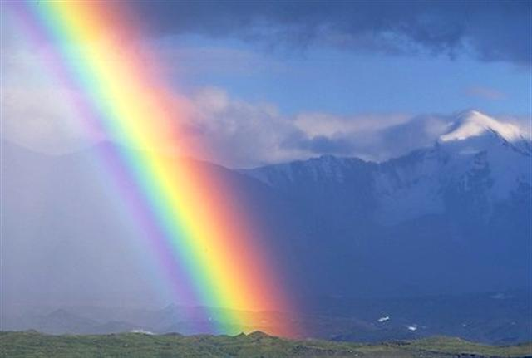
What is it?
I am purple, yellow, red, and green The King cannot reach me and neither can the Queen. I show my colours after the rain And only when the sun comes out again

Slide 13
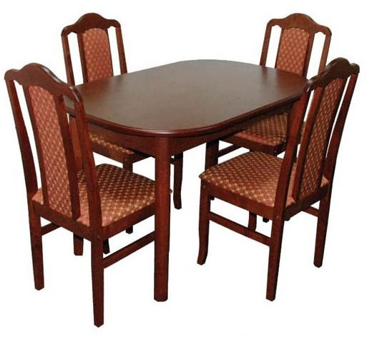
What is it?
We have legs but cannot walk.

Slide 14
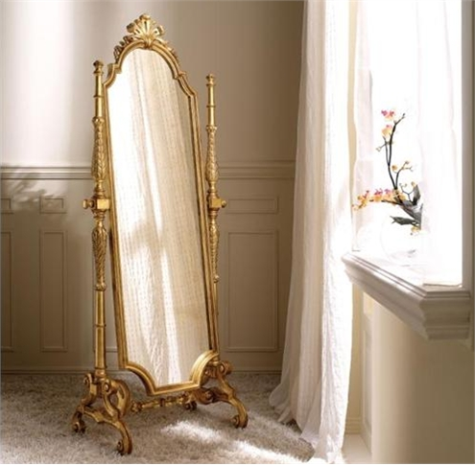
What is it?
Look at my face and you see somebody Look at my back and you see nobody

Slide 15
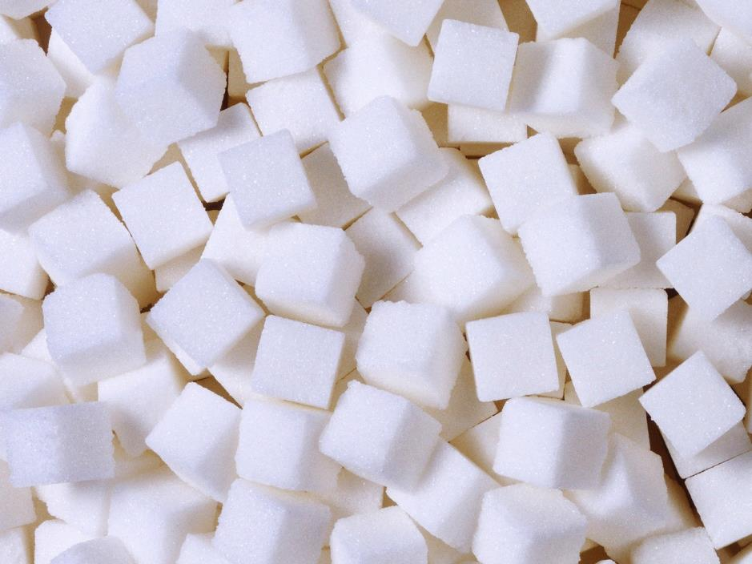
What is it?
Clean, but not water, White, but not snow, Sweet, but not ice-cream, What is it?

Slide 16
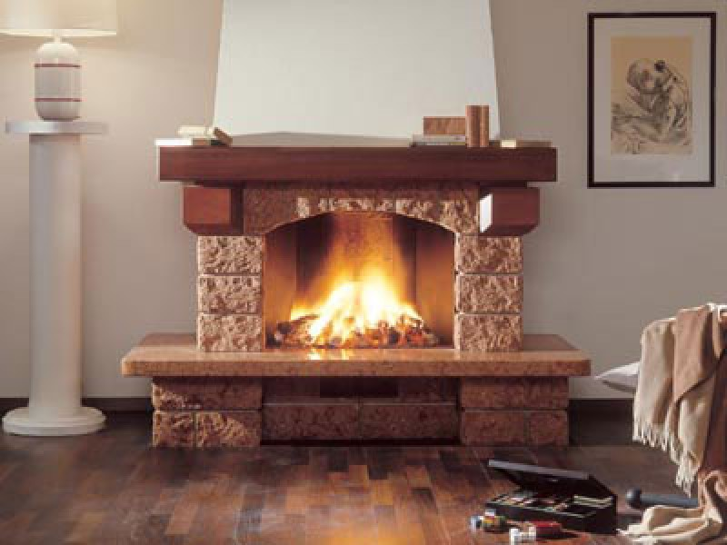
What is it?
eaiclfper

Slide 17
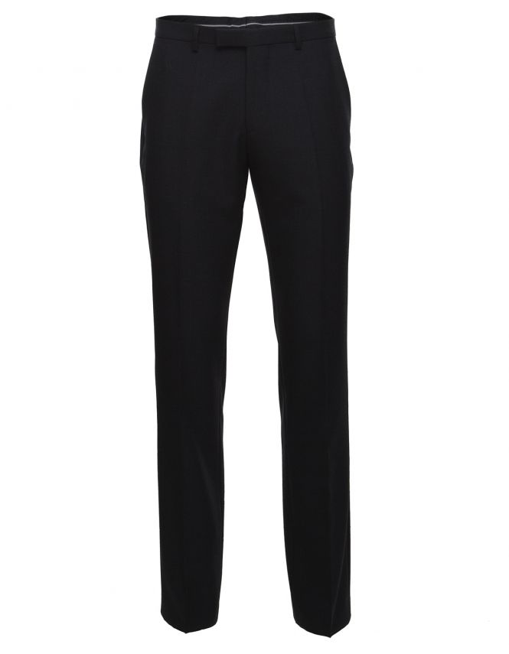
What is it?
esrortus

Slide 18
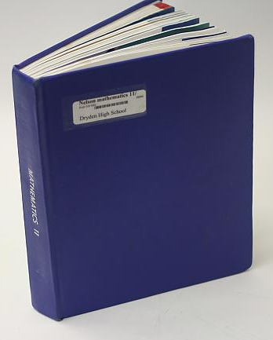
What is it?
beotoxtk
Textbook

Slide 19
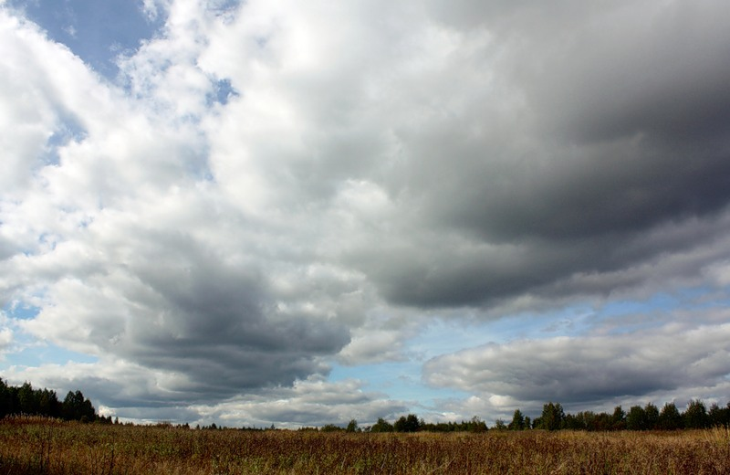
What is it?
uloycd

Slide 20
Grammar Station
“Are you good at English?”

Slide 21
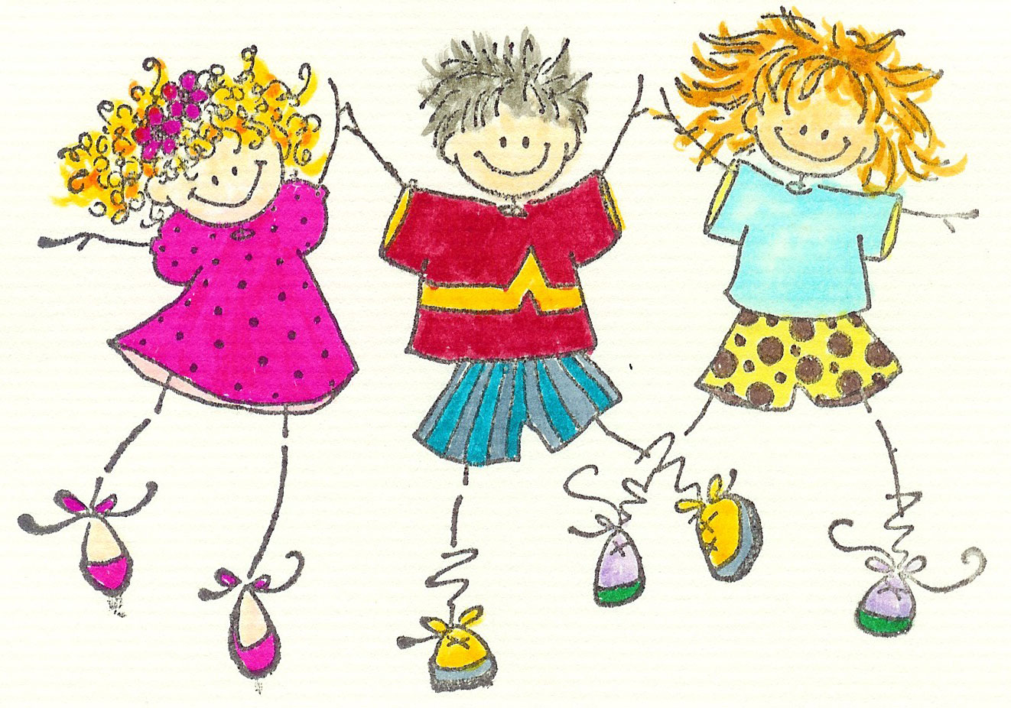
Let’s dance!!!

Slide 22
Choose the right answer

Slide 23
How many parts does the UK consist of?
a) 2 b) 3 c) 4

Slide 24
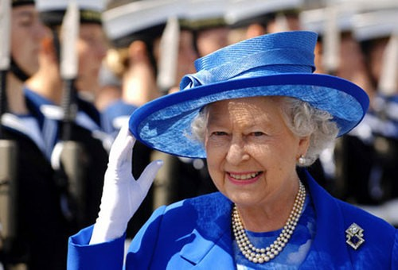
What is the capital of the UK?
a) Cardiff
b) London
c) England

Slide 25
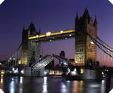
Name the river London is situated on.
a) the Avon
b) the Thames
c) the Clyde

Slide 26
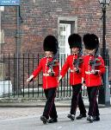
Who is the official head of the country?
a) Prime minister
b) President
c)Queen

Slide 27
The biggest clock in London is...
a) Union Jack
b) Big Ben
c) John bull

Slide 28
When do English children go from house to house and say : “Trick or treat?”
a) Christmas
b) Halloween
c) Easter

Slide 29
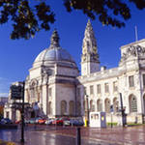
What plant is the symbol of England?
a) daffodil
b) red rose
c) thistle

Slide 30
Do you know English proverbs?

Slide 31
AN HOUR IN THE MORNING IS WORTH TWO IN THE EVENING.
УТРО ВЕЧЕРА МУДРЕНЕЕ.

Slide 32
EAST OR WEST HOME IS BEST.
В ГОСТЯХ ХОРОШО,
А ДОМА ЛУЧШЕ.

Slide 33
A FRIEND IN NEED is A FRIEND INDEED.
ДРУГ ПОЗНАЕТСЯ В БЕДЕ.

Slide 34
BETTER LATE THAN NEVER.
ЛУЧШЕ ПОЗДНО, ЧЕМ НИКОГДА.

Slide 35
A SOUND MIND IN A SOUND BODY.
В ЗДОРОВОМ ТЕЛЕ – ЗДОРОВЫЙ ДУХ.

Slide 36
Can you count?

Slide 37
Thirty-six plus sixty is …
Ninety-six

Slide 38
Seventy minus five is …
Sixty-five

Slide 39
Eighteen plus fifteen is …
Thirty-three

Slide 40
Twenty-four plus eight is…
Thirty-two

Slide 41
Try to guess

Slide 42
bra ‘ ‘ 5
brave

Slide 43
r ‘ ‘ m
room

Slide 44
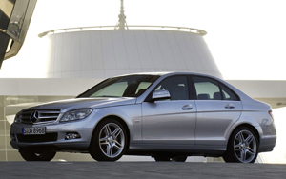
pet
carpet

Slide 45
shelf
bookshelf

Slide 46
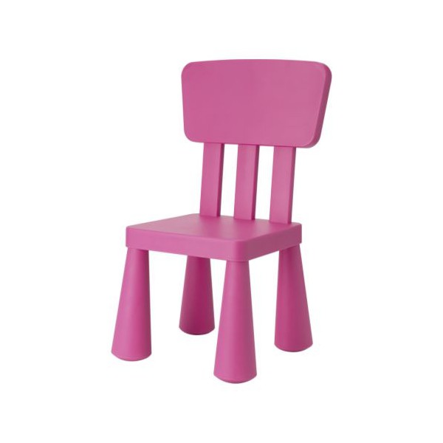
armchair

Slide 47
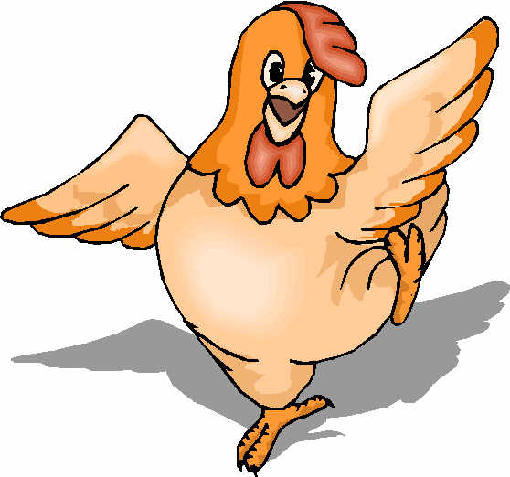
‘’’ ’ lp
help

Slide 48
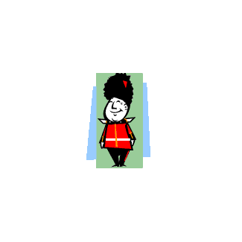
Thank you very much!!!

