Slide 1
What do you do to help your family?
Булатова С.В. МБОУ СШ
№ 5 г. Липецка

Slide 2
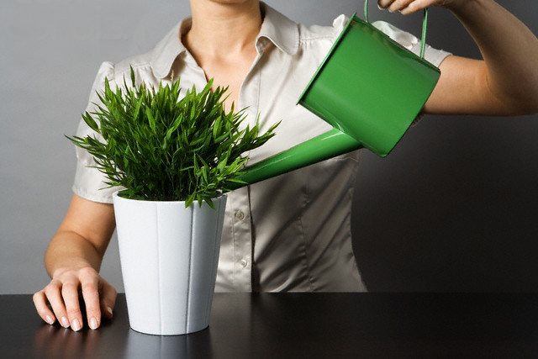
Water the flowers

Slide 3
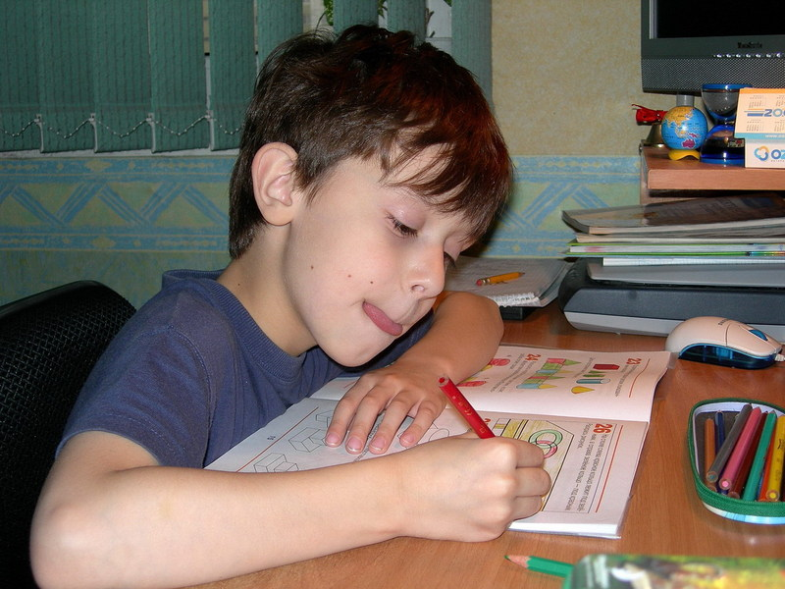
Do homework

Slide 4
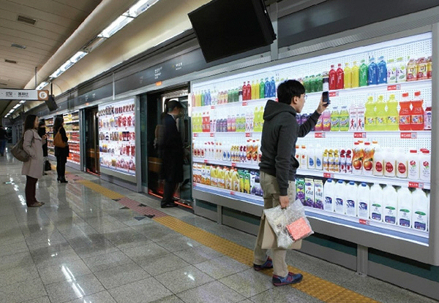
Go shopping

Slide 5
Make my bed

Slide 6
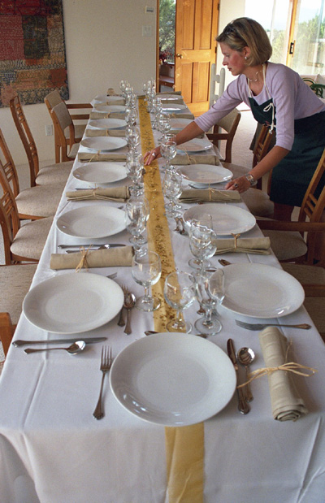
Lay the table

Slide 7
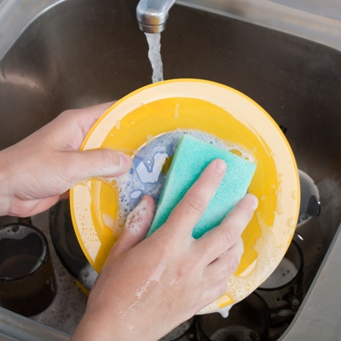
Do the washing up

Slide 8
Answer phone calls

Slide 9
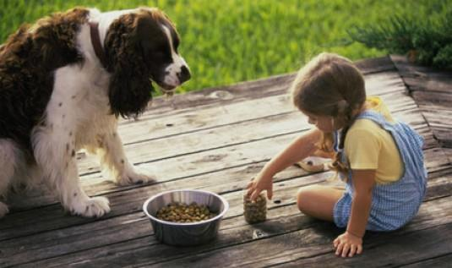
Feed my pets

Slide 10
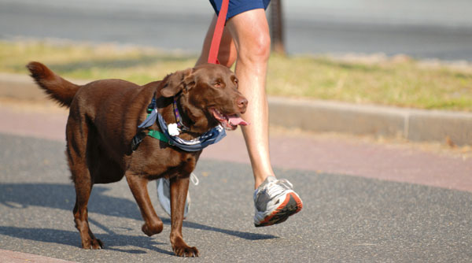
Take my pet for a walk

Slide 11
Repair my bike

Slide 12
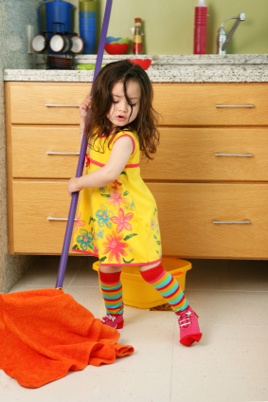
Clean my room

Slide 13
What did you do yesterday? I watered the flowers

Slide 14
I did my homework

Slide 15
I went shopping

Slide 16
I made my bed

Slide 17
I laid the table

Slide 18
I did the washing up

Slide 19
I answered phone calls

Slide 20
I fed my pets

Slide 21
I took my pet for a walk

Slide 22
I repaired my bike

Slide 23
I cleaned my room

Slide 24
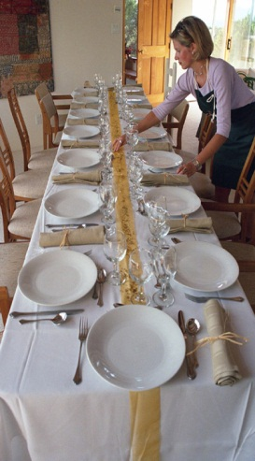
What did you do yesterday?

Slide 25
What did you do yesterday?

Slide 26
What will you do tomorrow?

Slide 27
What will you do tomorrow?

Slide 28
Well done!!

